Slide 1
Game App Project
By Emil Jacob and Shaheer Bakali

Slide 2
Scope of the Project
This project is an educational connecting dot game. In this game, the player is given a canvas in which an image with many dots is preloaded. The player has to connect dotted lines, which then reveal a particular animal that the player has to guess. This can be done through the following ways:
Choose the right name from choices
Write down the right name in text
Speak the right name through speech recognition.

Slide 3
Tools used for this project
Operating System : Windows 10
Web application Interfaces: HTML, Javascript, Jquery.

Slide 4
Specifications for the Project
Operating System: Windows 10, IOS
Browsers: Google Chrome, Microsoft Edge

Slide 5
Tasks for this project
Setting up development environment (using Jquery)
Develop canvas(using HTML and Javascript).
Handling title and flow of game.
Finishing.

Slide 6
Interface screens
Welcome Screen
Game Screen
Result Screen

Slide 7
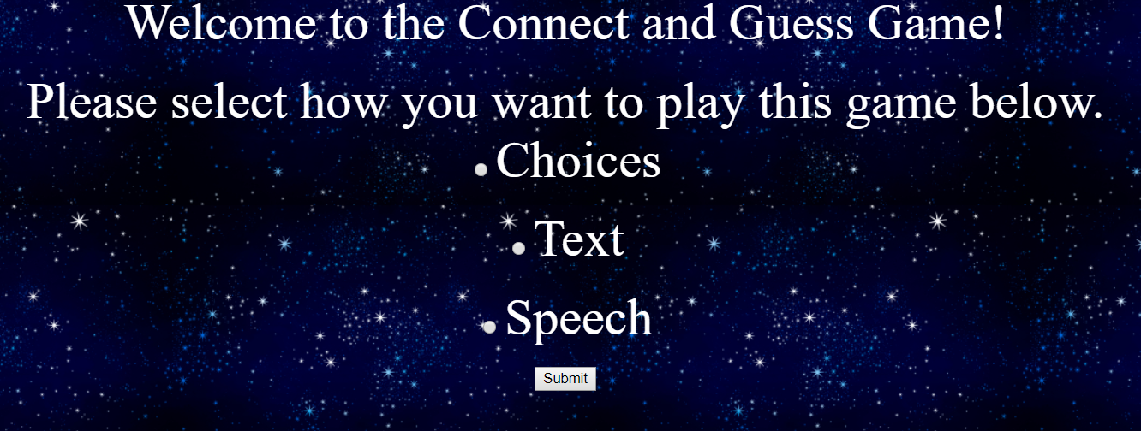
Welcome Screen

Slide 8
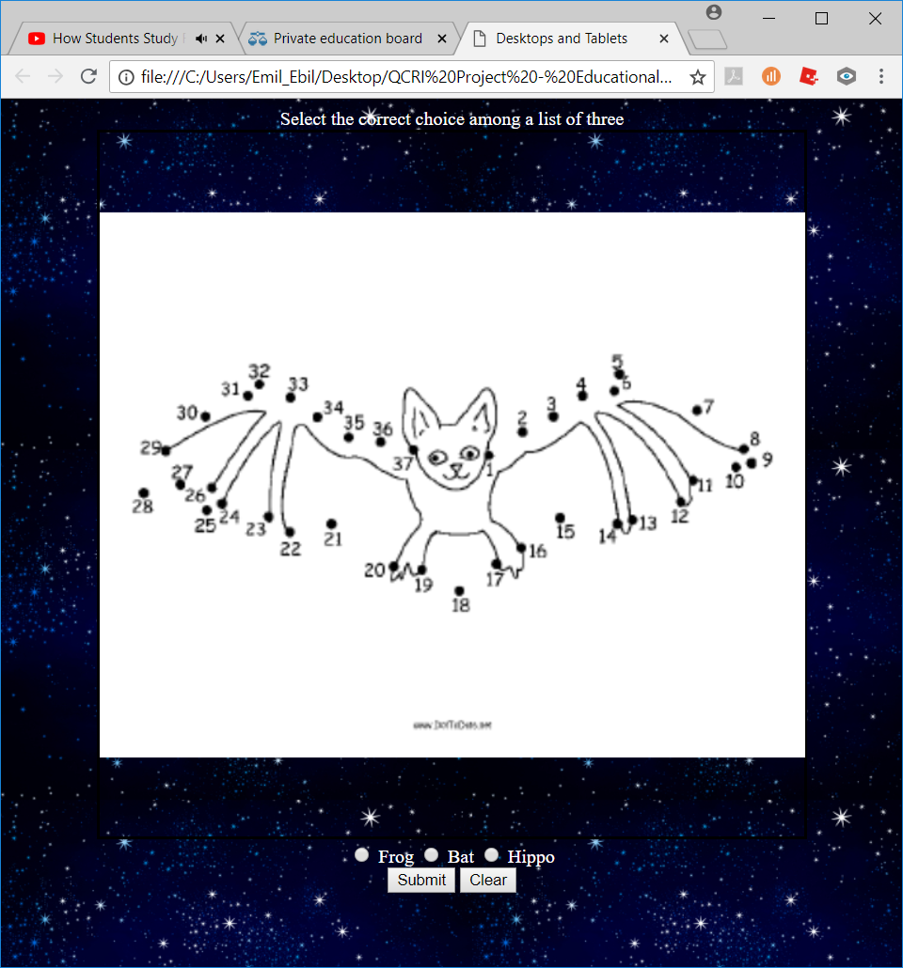
Game Screen (Choices)
Header
Canvas
Radio Options
Submit/Clear Button

Slide 9
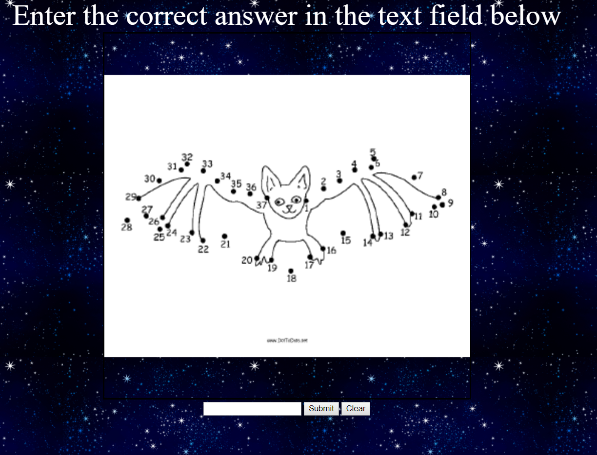
Game Screen (Text)
Header
Canvas
Text Entry Field
Submit/Clear Button

Slide 10
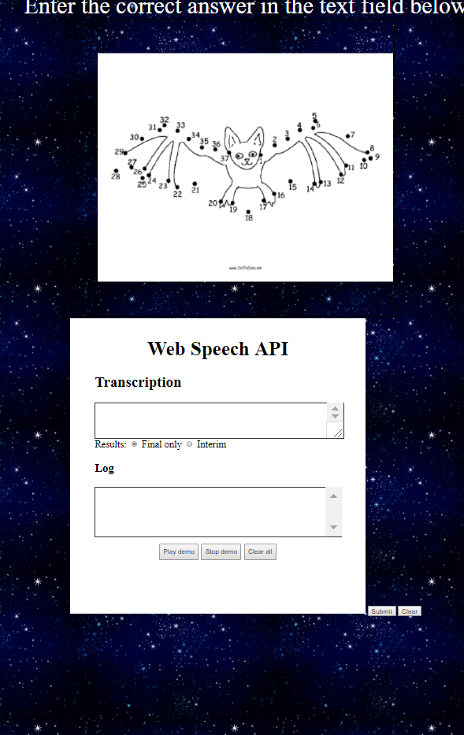
GAME SCREEN (SPEECH)
Header
Canvas
Speech API
Submit/Clear button

Slide 11


Result Screen

Slide 12
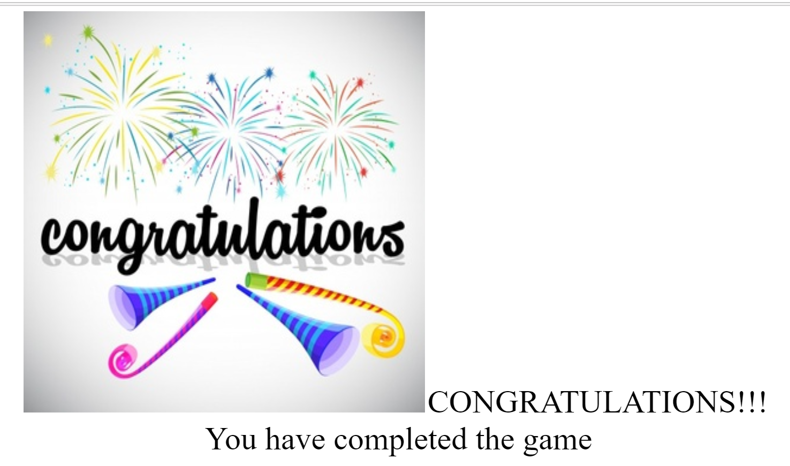
Final Screen

Slide 13
THANK YOU!!!

